Slide 1

DriverPass System Analysis
Thomas Tran
Professor Denise Washington
April 27th, 2025
Notes:
"Hello, today I’ll be presenting the system design for DriverPass, a platform to help students schedule driving lessons and prepare for their DMV tests."

Slide 2

System Requirements
Functional Requirements:
Students must be able to schedule a driving lesson through the DriverPass platform.
Students must be able to take online practice tests and receive immediate results after submit the test.
Students must be able to make secure online payments for lesson packages.
Nonfunctional Requirements:
The system must be available 99% of the time to ensure all users can access it reliably.
Sensitive data must be protected with encryption during transmission to ensure security.
The system must respond to action by 3 seconds to ensure a fast and smooth user experience.
Notes:
The requirements listed here are directly based on the core services DriverPass needs to offer its students and instructors for un-front uses.
For functional requirements, I included the ability to schedule a driving lesson, because this is a major feature DriverPass promises — helping students connect with instructors at convenient times. I also included the ability to take online practice tests, which is essential for helping students prepare for the DMV written exam. Finally, I added the ability to make secure online payments, because students need an easy way to purchase lesson packages through the website without calling or visiting in person.
For nonfunctional requirements, I focused on the system being highly available, since students and instructors need to reliably access DriverPass anytime. I included strong encryption to protect personal and payment information, which builds trust and meets privacy laws. Lastly, I made sure the system is fast, with pages loading within three seconds, to create a smooth, professional user experience and prevent frustration."

Slide 3
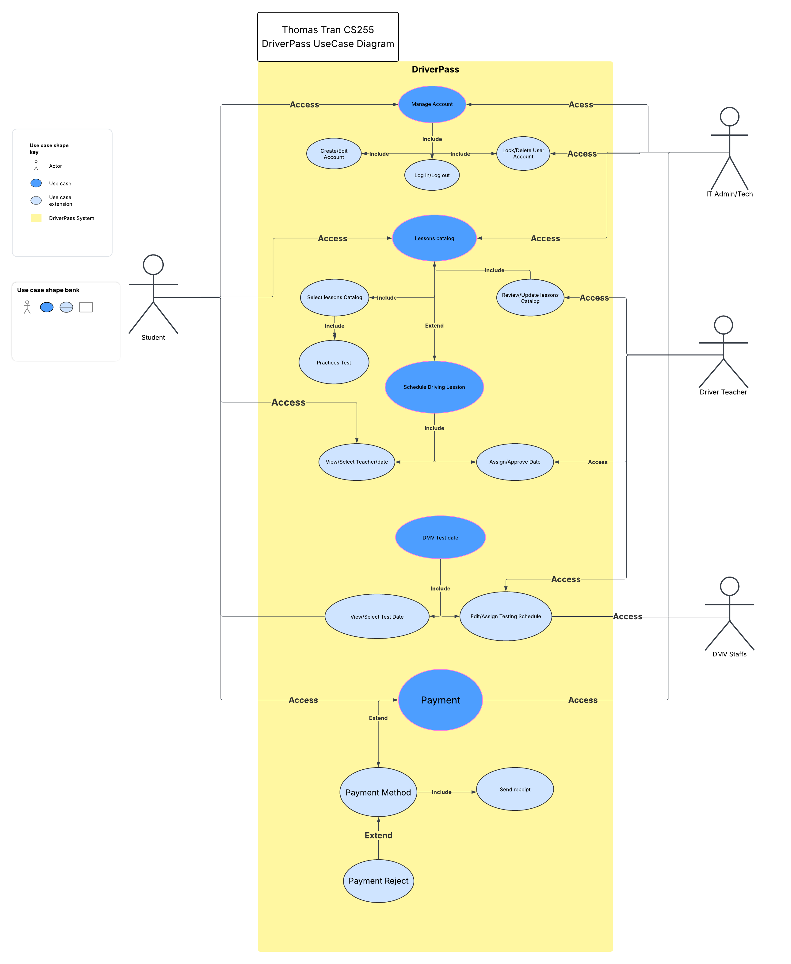
Use Case Diagram
Notes:
"This User Case diagram shows who will use the DriverPass system and what they’ll be able to do.
The main user will be the Student, Driving Instructor, IT Admin, DMV staff
Students can sign up, log in, pick lesson packages, schedule driving lessons, take practice tests, see available DMV test dates, and pay for their lessons.
Driving instructors can view and update the lesson schedules and approve student bookings.
The DriverPass technical team can manage student and instructor accounts, including lessons catalog and payment issues.
DMV staff can work with DriverPass to help manage test scheduling, they post available test date from the DMV for user and teacher.
Overall, I designed the system to make everything easy for students, instructors, and staff. The system focuses on helping students get ready for their driving tests, schedule lessons, and keep everything organized without needing a lot of extra help."

Slide 4
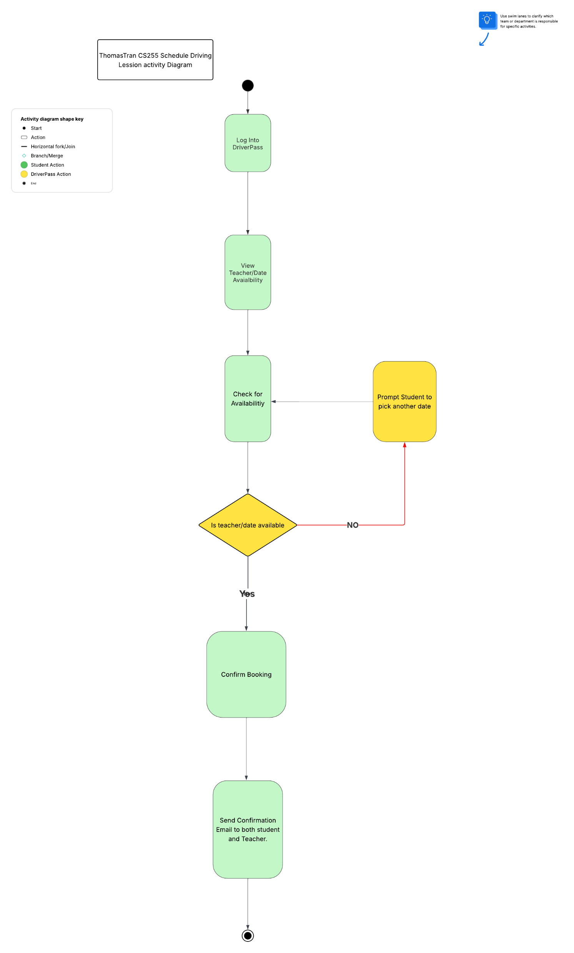
Driving Lesson Activity Diagram
Notes:
"This diagram here shows how the system helps a student schedule a driving lesson, step-by-step.
First, the student logs into DriverPass and asks to see available instructors and lesson times.
DriverPass checks the teacher database to find which instructors are available and what times they have open.
The available choices are then shown to the student.
The student selects a preferred date and instructor.
The system books the lesson, updates the instructor’s schedule, and sends a confirmation message back to the student.
I designed the steps this way to make scheduling as easy and fast as possible for students, while keeping the information accurate for instructors.
This setup supports DriverPass’s goal of providing a simple, reliable way for students to arrange their driving practice."

Slide 5
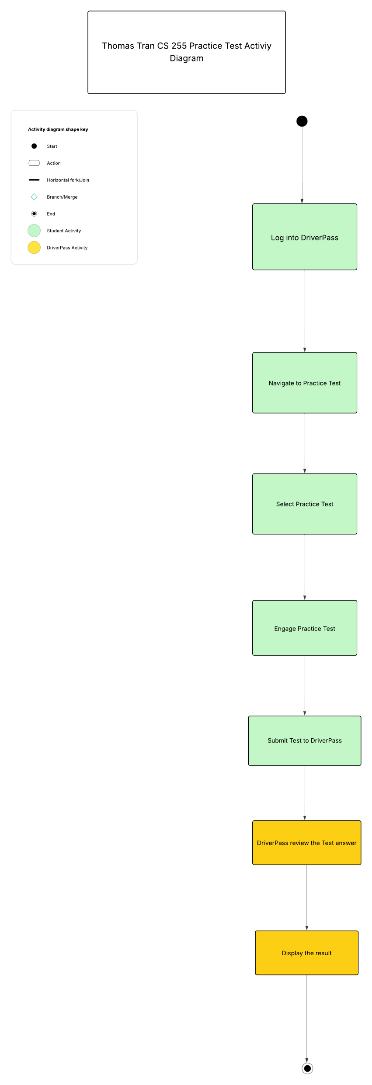
Practice Test Activity Diagram
Notes:
"This diagram shows the steps a student follows to complete a practice test on DriverPass.
First, the student logs into DriverPass. They then navigate to the practice test section from the dashboard.
After selecting which practice test, they want to take, the system loads the test.
The student answers the questions and then submits the test when finished.
DriverPass reviews the answers and calculates the student’s score.
Finally, the system shows the student their test results, including which answers were correct or incorrect.
I designed these steps to make it simple for students to practice for their DMV written exam.
It allows them to study at their own pace, get immediate feedback, and build their confidence before taking the real test."

Slide 6
Security
DriverPass Security Methods:
Secure Login: Students and instructors must log in with a username and password to access their accounts.
Multi-Factor Authentication (MFA): Users are required to verify their identity with an additional step.
Encrypted Connections: All data sent between users and DriverPass is protected using encryption.
Secure Payment Processing: All online payments are handled through trusted third-party providers.
User Account Management: Only authorized IT staff can create, update, or remove user accounts to prevent unauthorized access.
Regular Data Backups: DriverPass performs daily backups to ensure that user data is safe and can be quickly restored.
Role-Based Access: Users can only access the parts of the system that are appropriate for their role (student, instructor, DMV staff, or IT admin).
Notes:
"When designing DriverPass, I made sure that protecting user information was a top priority.
I included security measures for students and instructors to log in, so that only the right people can access their accounts like Secure Login, MFA, Encrypted Connection
I also made sure that all personal and payment information would be protected when it is sent through the system, by using safe communication methods..
Payments are handled through trusted services, and the system saves backups of important information every day.
For extra safety, I added a second layer of security for logging in, so even if someone’s password is stolen, their account stays protected.
Finally, the system is designed so that each user only sees the parts they need, which keeps everything more secure and easier to manage."

Slide 7
System Limitations
DriverPass System Limitation:
DriverPass requires a stable internet connection to access.
DriverPass has no offline access, user must have internet connection to access.
DriverPass require modern versions of popular web browsers (Chrome, Firefox, Edge, Safari) to access it.
DriverPass Initial launch will be limited to certain U.S. states before expanding nationwide.
There is limited support for Non-English speaker student user in the beginning.
Notes:
"There are a few limitations to the DriverPass system that users should be aware of:
First, students and instructors will need a working internet connection to use the system. If they lose internet access, they won’t be able to schedule lessons or take practice tests.
Second, DriverPass works best on newer web browsers like Chrome, Firefox, Edge, and Safari. Some older browsers may not show all features properly.
Third, the system does not offer an offline mode, so students and instructors must be online to use it.
Finally, at launch, DriverPass will only be available in certain states. We plan to expand nationwide later, but in the beginning, access will be limited.
Even with these limitations, DriverPass will still deliver an easy, flexible way for students to prepare for their driving tests and book lessons."

